Slide 1
Mission 2 Objective 2
Neural Networks
Credit: Peter McOwan and Paul Curzon of
Queen Mary, University of London
www.cs4fn.org
Notes:
Information on the slides is based on the cs4fn brain-in-a-bag activity
created by Peter McOwan and Paul Curzon of Queen Mary, University of London
For more see www.cs4fn.org

Slide 2
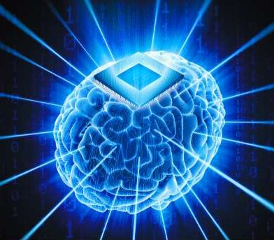
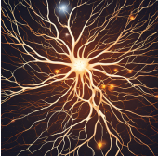
So what's in our head?
1
Billions of interconnected nerve cells called neurons
Very simple computing units, working together
Notes:
Biological brains are made of neurons. These are just brain cells. The human brain contains billions of neurons all connected together.
Each neuron has a central core and then lots of branches from this central core. The branches connect neurons together. Each neuron will be linked to lots of others.

Slide 3
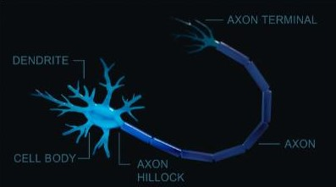
A simple model of a neuron
1
Notes:
Objective 1 introduced the three parts of a neuron: The dendrites, the soma and the axon.

Slide 4
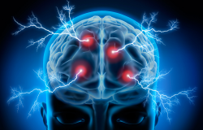
Neural messages
1
Electric pulses sent down the branches
Enough pulses must be sent to reach a threshold
Notes:
Neurons communicate with each other by sending electric pulse messages down the branches. The neurons that connect to other neurons send them messages. When enough pulse messages have arrived to reach a threshold, the neuron fires. Then it sends a pulse message to all the neurons it connects out to. Each neuron has its own threshold that determines when it fires.

Slide 5
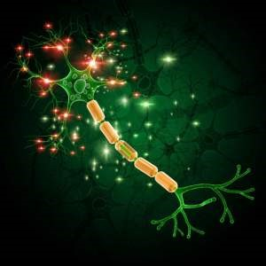

Neural messages
1
M3
M1
M2
Once enough “messages” have been sent, the neuron fires “messages” to connected neurons
Notes:
Think of sending signals like tapping a balloon to the ceiling. Each pulse represents a tap on the balloon, pushing it up in the air. But if it doesn’t receive multiple “taps” quickly, it starts to fall. Some signals, or taps, are stronger than others. When the balloon reaches the ceiling, it “fires” a signal to the next balloons, like a relay.

Slide 6
Mission 2 Objective 2
Unplugged Chain
Creating an artificial neural network

Slide 7
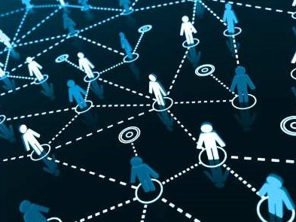
Unplugged Chain
1
Students will be the neurons
Notes:
Each of you will have a role to play in this simulation. You will be an eye neuron, a brain neuron or the final neuron. You will receive signals from neurons that connect to you. When you reach your threshold, you will in turn send signals to your connecting neurons.

Slide 8
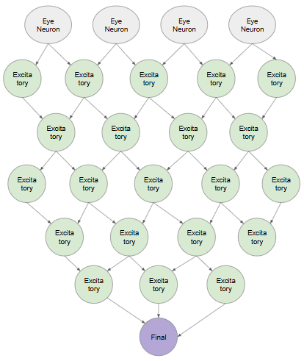
Unplugged Chain
1
A deck of cards will represent the electric pulse “messages.”
The final neuron will perform the action.

Slide 9
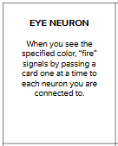
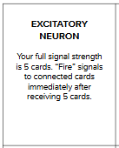
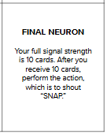
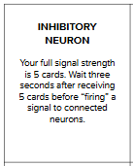
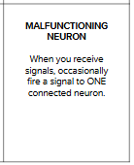
Unplugged Chain
1
All the information for your part is on the role cards.

Slide 10
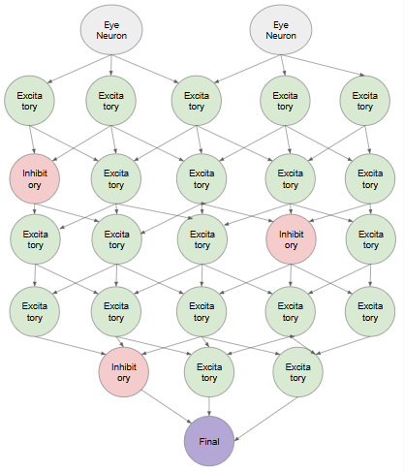
Unplugged Chain
1
We will repeat the simulation several times.
You can get a new role each time.
We will try different configurations of neural networks.
But the rules remain the same: reach your threshold and then “fire.”

Slide 11
Scenario #1
1

Slide 12
Scenario #2
1

Slide 13
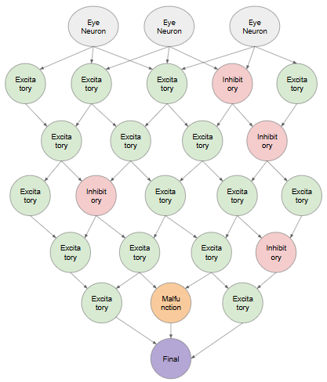
Scenario #3
1

Slide 14
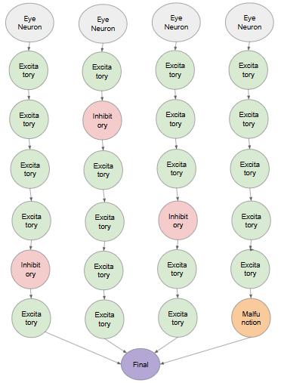
Scenario #4
1

Slide 15
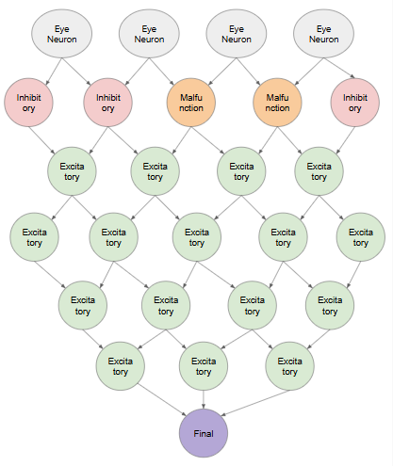
Scenario #5
1

